Slide 1
THIRD GRADE
By: Third Grade Teachers
Welcome Families, please find your child’s desk and enjoy reading a personal letter from them. To encourage them as writers, please write them a response note.

Slide 2
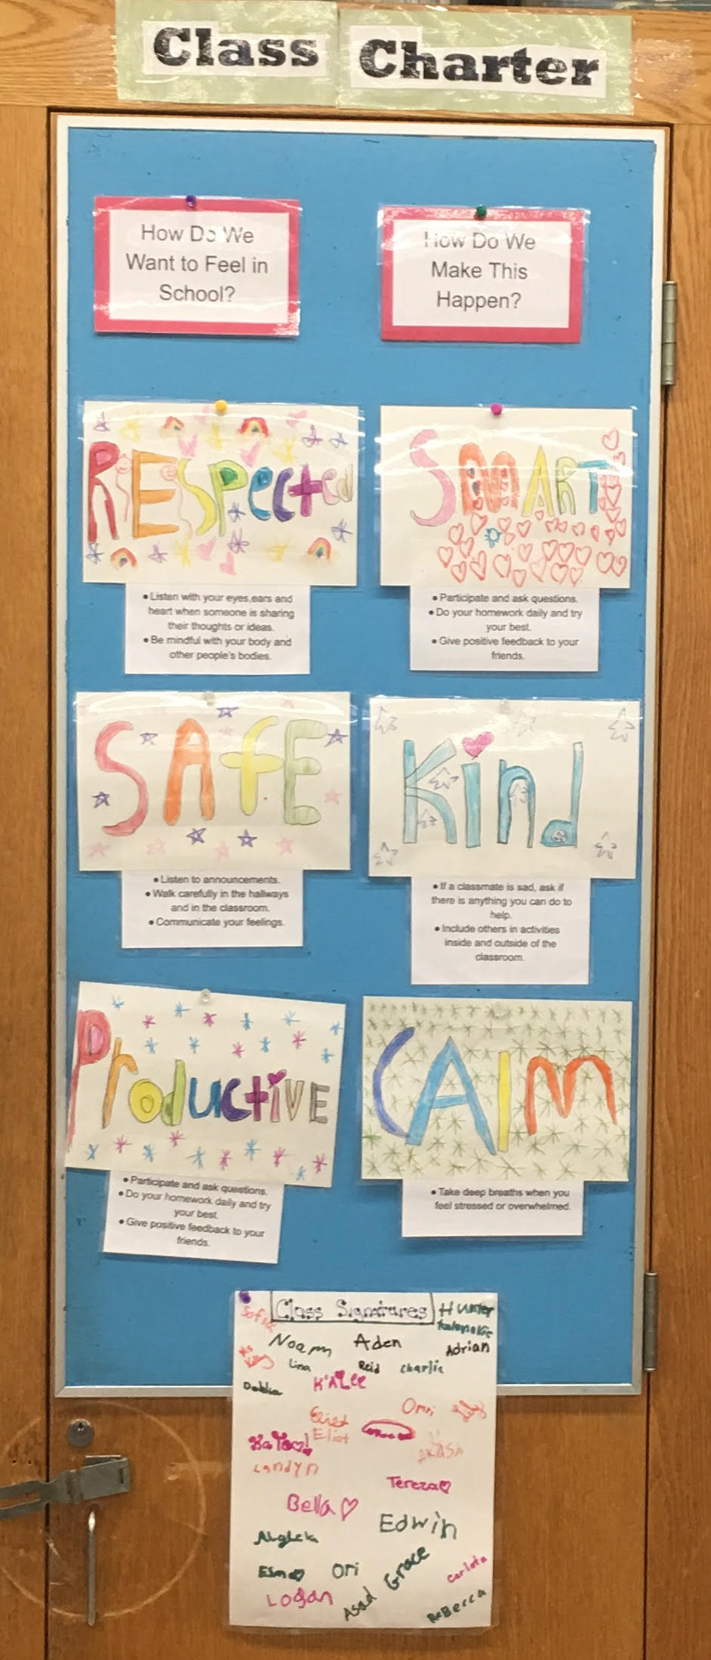
Class Charter

Slide 3
Class Incentives
Table Points (group incentive)
“Kelly Cash” (individual incentive)
Community Jar (whole class)
Marble Jar (whole class)

Slide 4
A Typical Day
Time Period | Activity
8:20 AM-9:10 AM | Morning Work, Math Journal Task, Number Talks, Screeners
9:14 AM-10:04 AM | Reading Workshop
10:08 AM-10:58 AM | Writing Workshop
11:02 AM-11:52 AM | Math
11:56 AM-12:46 PM | Recess and Lunch
12:50 PM-1:40 PM | Special Class
1:44 PM-2:40 PM | Science/Social Studies

Slide 5
Prep Schedule
Day | Prep | Time
Monday | Music | 12:50-1:40
Tuesday | Theater | 12:50-1:40
Wednesday | Technology | 12:50-1:40
Thursday | Physical Education | 12:50-1:40
Friday | Art | 1:44-2:40

Slide 6
Homework
Homework Packets
Weekly and due on Mondays
Students are responsible for their homework materials (math homework notebook, Reading and Writing notebooks and homework folder( building and encouraging independence)
Homework Help
Reading Logs - pages read, read for at least 30 minutes, to build stamina.

Slide 7
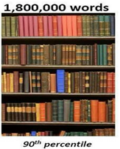
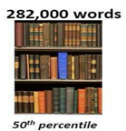
Why Can’t I Skip My 20 Minutes of Reading Tonight?
Student “A” reads 20 minutes each day | Student “B” reads 5 minutes each day | Student “C” reads 1 minute each day
3600 minutes in a school year | 900 minutes in a school year | 180 minutes in a school year

Slide 8
Reading Levels Slide
September | November | January | March | June
1 = K or below 2 = L 3 = M 4 = N or above | 1 = K or below 2 = L/M 3 = N 4 = O or above | 1 = L or below 2 = M/N 3 = O 4 = P or above | 1 = M or below 2 = N 3 = O 4 = P or above | 1 = N or below 2 = O 3 = P 4 = Q or above

Slide 9
Reading Curriculum
Teachers College Workshop Model
Reading: Focus on building reading stamina, volume and comprehension
Stop and jots capture thinking during independent reading
Reading Partners and Book Clubs (Building a Reading Life, Mystery, Research Clubs, Social Issues) - student driven discussions.
Nonfiction: Grasping Main Idea and Text Structures
TC Assessments for Reading Levels - 96% accuracy, fluency, inferential comprehension

Slide 10
Writing Curriculum
Types of Writing: Narrative, Information, Opinion, Baby Literary Essay and Fairytales
Writing Expectations: Writing at least a full notebook page each day to build stamina
Writing HW - 2-3 times a week, same length as class writing
Self-Assessments using student checklist
Writing Partnerships and Peer Editors

Slide 11
Mathematics:
Math Units aligned with Next Generation Standards
Number talk
Screeners
Math Rotations
Telling Time
Math Homework Notebook
Math Journal Tasks / Role of Math Notebook
Unit Topics: Addition & Subtraction, Multiplication & Division; Place Value & Problem-Solving with Mass, Time, and Capacity; Fractions; Area; Collecting and Displaying Data; Geometry: Quadrilaterals
Math Projects - real world application of concepts/skills learned during math workshop

Slide 12
Math Rotations
Red | Green | Blue
Mini Lesson | Games | Independent Work
Independent Work | Mini Lesson | Games
Games | Independent Work | Mini Lesson

Slide 13
Math Basic Facts
Fact | Strategy
x2 | Double
x3 | Double and add 1 group
x4 | Double, double
x5 | Multiply by ten, then halve
x6 | Times 5 and add 1 group
x7 | Times 5 and add double
x8 | Double, double, double
x9 | Times 10, minus 1 group

Slide 14
Science
Amplify: (hands-on experiments, scientific thinking, habits of scientists)
1. Measurement
2. Inheritance and Traits
3. Weather
4. STEM Activity (science, technology, engineering and mathematics)

Slide 15
Social Studies
Teacher’s College Units – Incorporating reading and writing skills within Social Studies
Research – Varied Note Taking Strategies (sketch, boxes and bullets, lists)
Units of Study: World Geographies and World Communities differentiated based on student’s interest (China, Nigeria, Brazil, Italy, Greece)

Slide 16
General Information
Birthday Policy: In class celebration with students
We celebrate all the birthdays of the month on the last Friday of each month.
We are adopting a no food birthday party policy, however your child can bring in something to share for show and tell.

Slide 17
Parent/Teacher Communication
Class Website: class306.educatorpages.com
(Important Dates, Monthly Newsletters, Connecting to the Classroom, Test Prep)
Communicating with Me
Email: kplater@ps166.org
Write me a note in my mailbox or sent with your child.
Call the school and leave a message.

Slide 18
State Testing
New York State English Language Arts exam (ELA)
March 25th – March 26th
2-Day Exam (multiple choice, short answer and extended response)
Administered to assess students’ progress toward the Common Core Standards in English Language Arts.
New York State Mathematics Test
April 21st – April 22nd
2-Day Exam (multiple choice, short answer and extended response)
Administered to assess students’ progress towards the Common Core standards in Mathematics.
For more information on any of the tests listed above, go to the
New York State Department of Education website at:
http://www.p12.nysed.gov/assessment/ei/eigen.html

